Slide 1

MINI PROJECT REPORT
ON
DIGITAL SYSTEM AND DESIGN
DRIVER SAFETY MANAGEMENT SYSTEM
Project Mentor Professor Sushil Kumar Pandey By -
Tejas Rahul M(221EC161)
Rajkumar Walke(221EC144)
National Institute of Technology Karnataka,
Surathkal, Mangalore – 575025
1

Slide 2
Certificate
This is to certify that the Mini-Project Title entitled “Driver Safety Management System” submitted by Tejas Rahul M (221EC161) as the record of the mini-project work carried out by him, is accepted as the Final Mini-Project Report in partial fulfilment of the requirements for the award of degree of Bachelor of Technology.
Dr Sushil Kumar Pandey
Project Mentor
Assistant Professor
Department of Electronics and Communication Engineering
NITK Surathkal – 575025
Dr. Nikhil S
Mini-Project Faculty Associate Professor
Department of Electronics and Communication NITK Surathkal – 575025
This project presents the development of Driver Safety Management System which can evaluate the overall safety of the driving environment. This has been done with the use of 8 sensors (bioelectric and other physical sensors)
2

Slide 3
The bioelectric sensors are used for the measurement of ECG, Blood Vessel Thickness, Blink Rate, Sweating
Other physical sensors include Over speeding, front proximity, side proximity and steering wheel angle change monitor
With the aim of emphasising more on certain sensor values more than the others, the sensors are divided into two modules, High priority and Low priority
High Priority Sensors include ECG, Blood Vessel Thickness, Blink Rate, Front Proximity and Steering wheel angle change
Low Priority Sensors include Over Speeding, Side Proximity and Sweating
Together, all the severities of the warnings given by each sensors modules are assessed and High priority and Low priority modules are combined to give a final output
3

Slide 4
TABLES OF CONTENTS
S. no. | Topic | Page number
1. | INTRODUCTION | 5
2. | MOTIVATION | 6
3. | LITERATURE REVIEW | 7
4. | METHODOLOGY AND RESULT | 9
5. | FUTURE SCOPE | 35
6 | CONCLUSION | 36
7 | REFERENCES | 37
4

Slide 5
I. Introduction
In this project, a digital system which is aimed at assessing the safety of the vehicle depending on various factors
The project is aimed at improving the safety of road transportation
A software for the simulation of the circuit has been used
Multiple digital circuit components such as adders, comparators, encoders, multipliers and numerous gates of varying number of inputs have been used
The different threshold values can be changed and the system can be modified for different purposes
5

Slide 6
II. Motivation
A Driver Status Monitoring System (DSMS) is crucial for enhancing road safety by continuously assessing driver behavior and alerting to potential risks. It detects signs of fatigue, distraction, or impairment, which are major contributors to road accidents. DSMS offers real-time monitoring, allowing for timely intervention to prevent accidents. Particularly beneficial for commercial vehicles and long-haul transportation, DSMS ensures drivers maintain focus and attentiveness, reducing the likelihood of incidents caused by driver-related factors. Integration with Advanced Driver Assistance Systems (ADAS) further amplifies its effectiveness, creating a comprehensive safety ecosystem for modern vehicles.

Slide 7
III. Literature Review
Y. Choi, S. I. Han, S. -H. Kong and H. Ko, "Driver Status Monitoring Systems for Smart Vehicles Using Physiological Sensors: A safety enhancement system from automobile manufacturers," in IEEE Signal Processing Magazine, vol. 33, no. 6, pp. 22-34, Nov. 2016, doi: 10.1109/MSP.2016.2602095.
keywords: {Electrocardiography; Biomedical monitoring; Smart devices; Wireless sensor networks; Vehicle safety; Accidents; Traffic control;Physiology;Intelligent vehicles},
This paper talks more about the ECG and PPG sensors and assessing these sensor outputs and the noise cancellation involved in the process, furthermore, the advantages of these systems over the conventional ones have been discussed.
The advantages of using bioelectric sensors over other sensors for the safety assessment have been discussed as well

Slide 8
Qiong Wang, Huan Wang, Chunxia Zhao and Jingyu Yang, "Driver fatigue detection technology in active safety systems," 2011 International Conference on Remote Sensing, Environment and Transportation Engineering, Nanjing, 2011, pp. 3097-3100, doi: 10.1109/RSETE.2011.5964969. keywords: {Driver circuits;Fatigue;Monitoring;Vehicles;Safety;Real time systems;Roads;active safety; fatigue detection; driver monitoring system},
This paper lays emphasis on the fatigue detection by various means and by making use of various sensors and also sheds light on the algorithms used in certain parameter measurements such as eye closure amount, blink rate etc
8

Slide 9
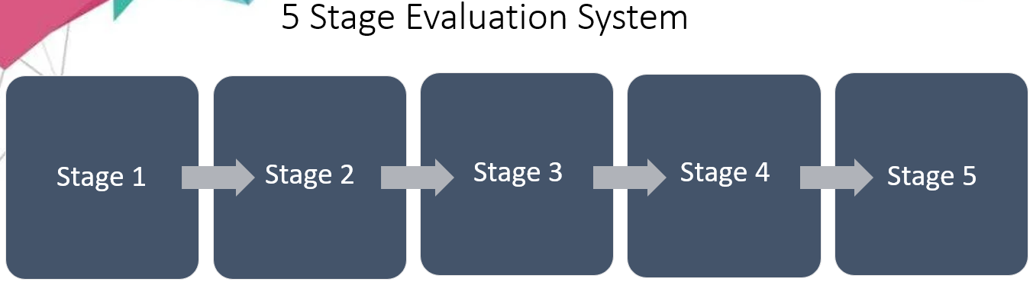
IV. Methodology and result
Implemented a digital module for each of the senor being incorporated in the system
The working software simulation has been demonstrated on Logisim
The system consists of 8 sensors
For prioritizing certain sensor over others, the sensors have been divided into High Priority and Low Priority
High Priority Sensors include :ECG, PPG, Blink Rate, Front Proximity, and Steering Angle Change sensors
Low priority sensors include : Lateral Proximity, Over speeding, and Perspiration sensors
Further assessment of the warnings given by the sensors in done in a stage wise manner.

Slide 10
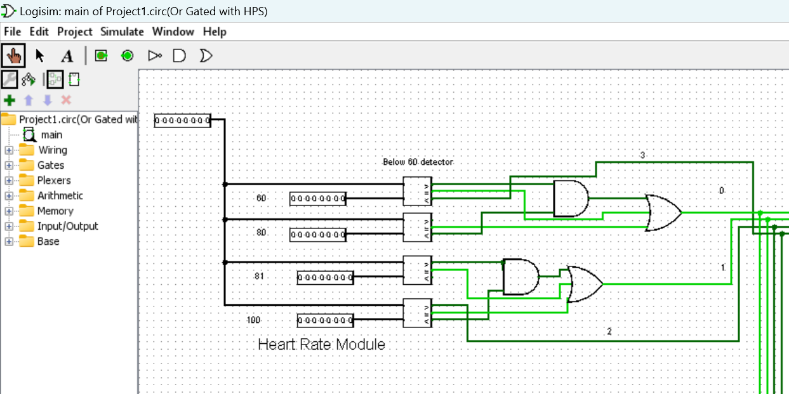
Stage 1
The inputs are taken to each of the sensor modules
Each sensor module compares the input against a pre decided value
Each module produces an output ranging from 0 to
3(3being the most severe and 0 being the least)
10

Slide 11
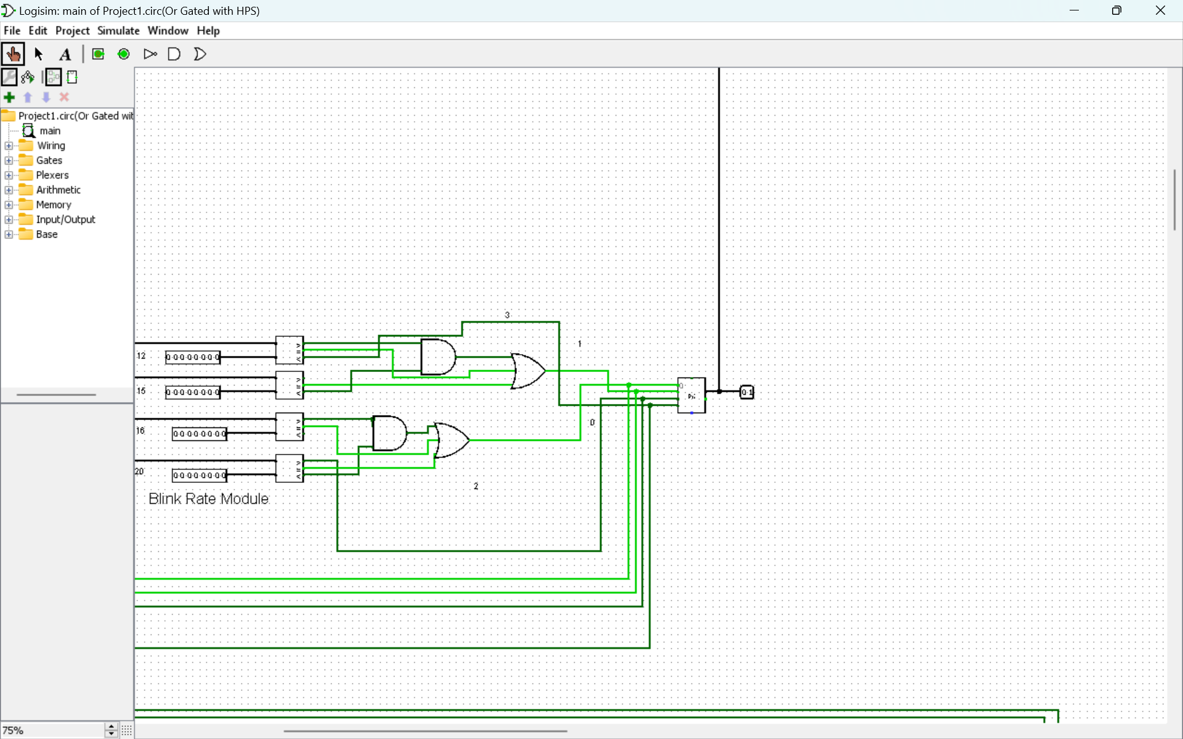
Stage 2
Warning are encoded using a priority encoder
11

Slide 12
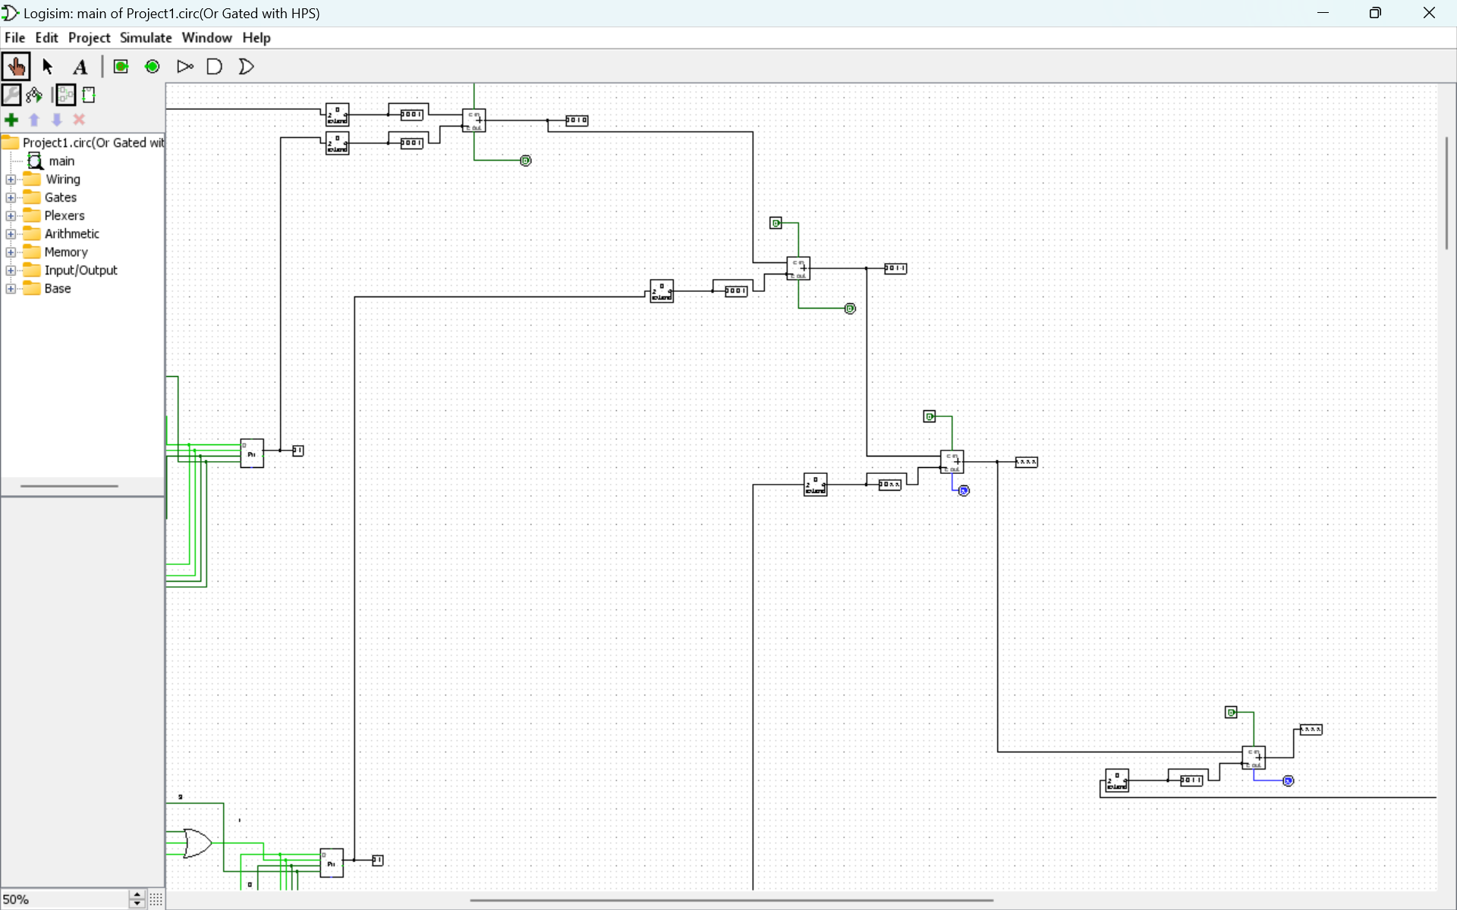
Stage 3
The encoded values are added using adders(multiple)
12

Slide 13
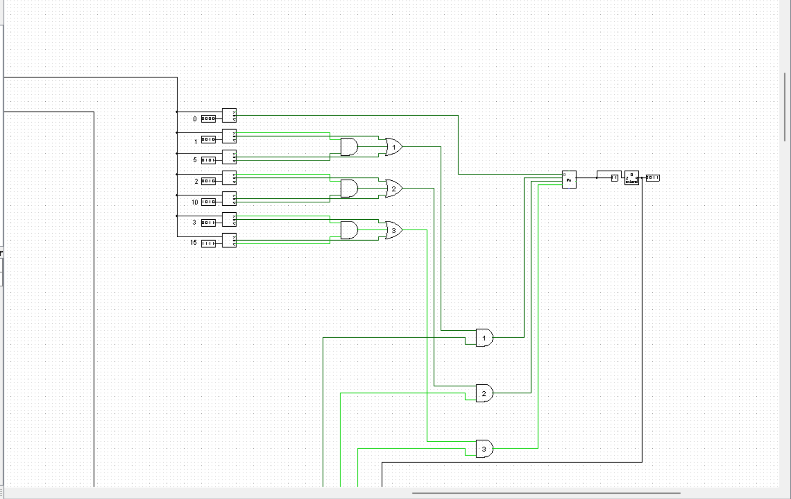
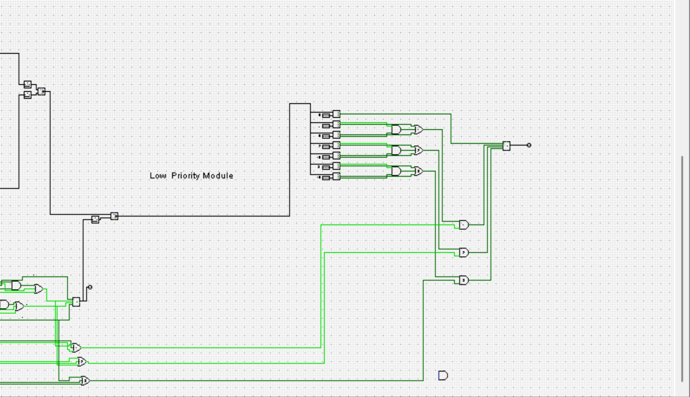
Stage 4
The Combined Severities of all the high priority
sensors is calculated
The Combined Severities of all the low priority
sensors is calculated
13

Slide 14
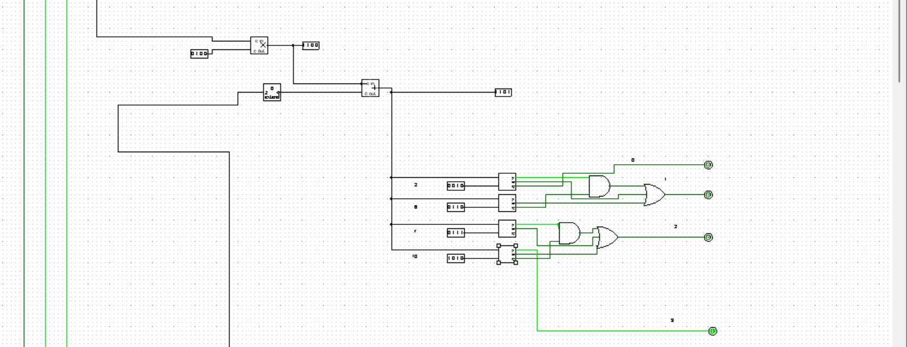
Stage 5
High Priority module and low priority modules are integrated together
Final Output is given, this can be used in many different ways and multiple actions can be taken depending on the severity
14

Slide 15
The combined assessment of High Priority and Low Priority module is based on the following truth table
 | High Priority Output(5 sensors combined) | Low Priority Output(3 sensors combined) | Output Severity 3 | Output Severity 2 | Output Severity 1 | Output Severity 0
0 | 00 | 00 | 0 | 0 | 0 | 1
1 | 00 | 01 | 0 | 0 | 0 | 1
2 | 00 | 10 | 0 | 0 | 1 | 0
3 | 00 | 11 | 0 | 0 | 1 | 0
4 | 01 | 00 | 0 | 0 | 1 | 0
5 | 01 | 01 | 0 | 0 | 1 | 0
6 | 01 | 10 | 0 | 0 | 1 | 0
7 | 01 | 11 | 0 | 1 | 0 | 0
8 | 10 | 00 | 0 | 1 | 0 | 0
9 | 10 | 01 | 0 | 1 | 0 | 0
10 | 10 | 10 | 0 | 1 | 0 | 0
11 | 10 | 11 | 1 | 0 | 0 | 0
12 | 11 | 00 | 1 | 0 | 0 | 0
13 | 11 | 01 | 1 | 0 | 0 | 0
14 | 11 | 10 | 1 | 0 | 0 | 0
15 | 11 | 11 | 1 | 0 | 0 | 0
15

Slide 16
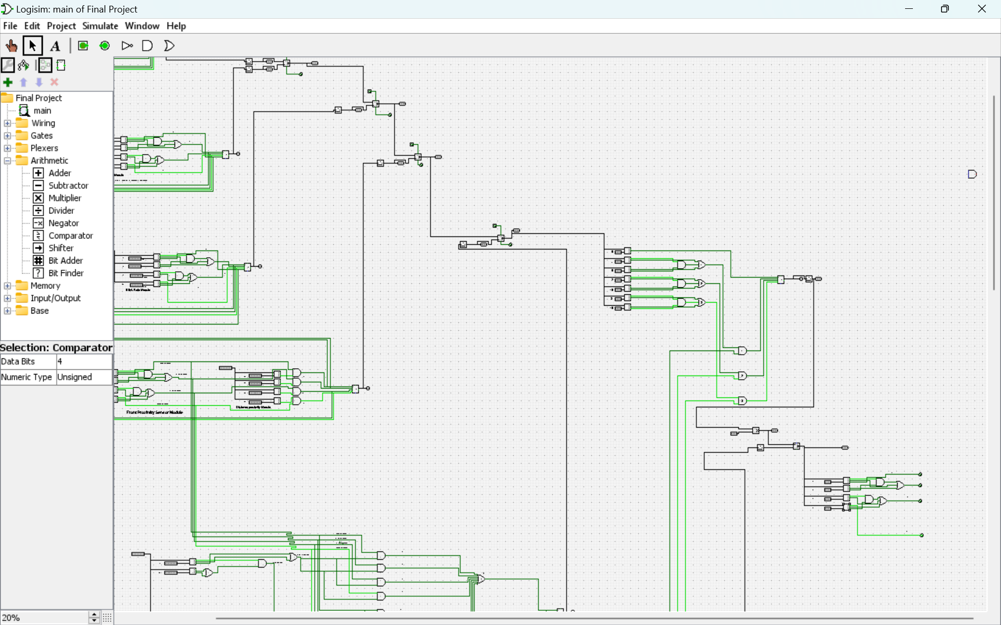
16

Slide 17
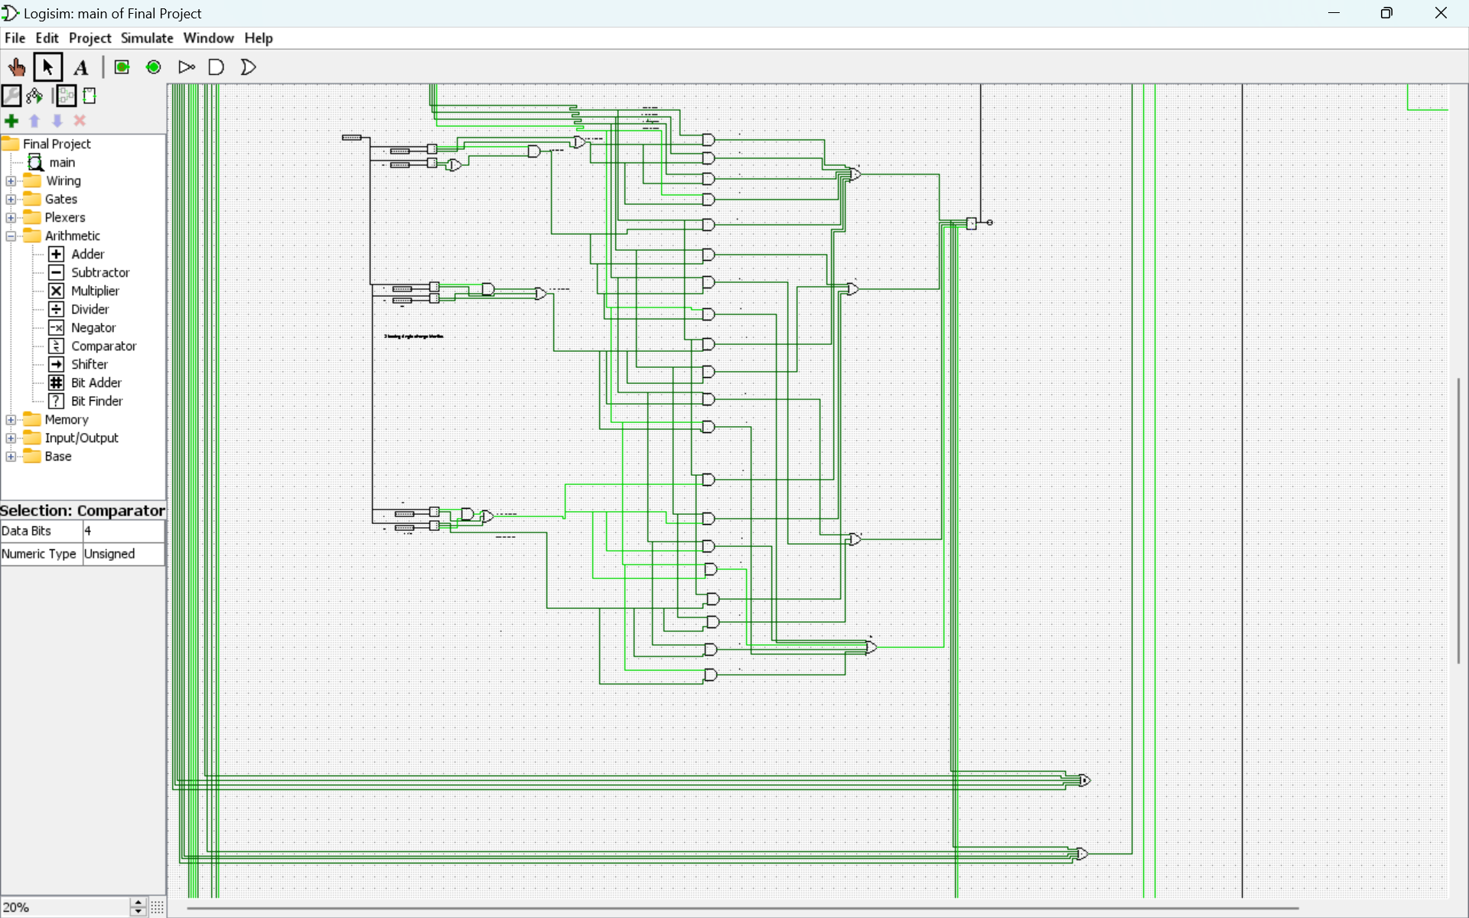
17

Slide 18
18

Slide 19
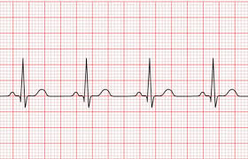
Heart Rate Module
The Heart Rate Module exhibits warning classifications corresponding to distinct heart rate ranges as follows:
Heart rates ranging from 0 to 60 beats per minute (bpm) trigger Warning Level 3.
Heart rates between 61 and 80 bpm are associated with Warning Level 0.
Heart rates ranging from 81 to 100 bpm elicit Warning Level 1.
Heart rates exceeding 100 bpm prompt Warning Level 2.
19

Slide 20
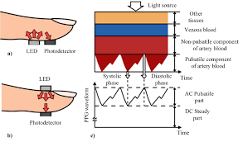
Blood Vessel Thickness
The PPG Module's warning levels are determined based on the magnitude of photoplethysmography (PPG) signal fluctuations, delineated as follows:
Signal amplitudes below 5 x 10⁻⁴ meters are associated with Warning Level 3.
Signal amplitudes ranging from 5 x 10⁻⁴ meters to 15 x 10⁻⁴ meters units correspond to Warning Level 0.
Signal amplitudes within the range of 16 x 10⁻⁴ meters to 20 x 10⁻⁴ meters units elicit Warning Level 1.
Signal amplitudes exceeding 20 x 10⁻⁴ meters units trigger Warning Level 2.
20

Slide 21

Blink Rate Module
The Blink Rate Module, dedicated to assessing blink frequency, categorizes warning levels based on blink counts as follows:
Blink rates ranging from 0 to 12 blinks per minute correspond to Warning Level 3.
Blink rates between 12 and 15 blinks per minute elicit Warning Level 1.
Blink rates within the range of 16 to 20 blinks per minute are associated with Warning Level 0.
Blink rates exceeding 20 blinks per minute prompt Warning Level 2.
21

Slide 22
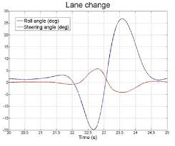
Steering Wheel Angle Change monitor
The integration of the Steering Angle Change Monitor with speed classification yields the following warning levels:
For speeds below 40 kmph:
Steering angle changes ranging from 0 to 10 degrees elicit Warning Level 0.
Steering angle changes between 11 and 30 degrees correspond to Warning Level 0.
Steering angle changes within the range of 31 to 120 degrees are associated with Warning Level 0.
Steering angle changes spanning from 120 to 180 degrees prompt Warning Level 0.
Steering angle changes exceeding 180 degrees trigger Warning Level 1.
22

Slide 23
Steering Wheel Angle Change monitor contd..
The integration of the Steering Angle Change Monitor with speed classification yields the following warning levels:
For speeds below 41 kmph to 60 kmph:
Steering angle changes ranging from 0 to 10 degrees elicit Warning Level 0.
Steering angle changes between 11 and 30 degrees correspond to Warning Level 1.
Steering angle changes within the range of 31 to 120 degrees are associated with Warning Level 1.
Steering angle changes spanning from 120 to 180 degrees prompt Warning Level 1.
Steering angle changes exceeding 180 degrees trigger Warning Level 2.
23

Slide 24
Steering Wheel Angle Change monitor contd..
The integration of the Steering Angle Change Monitor with speed classification yields the following warning levels:
For speeds below 60 kmph to 90 kmph:
Steering angle changes ranging from 0 to 10 degrees elicit Warning Level 0.
Steering angle changes between 11 and 30 degrees correspond to Warning Level 2.
Steering angle changes within the range of 31 to 120 degrees are associated with Warning Level 2.
Steering angle changes spanning from 120 to 180 degrees prompt Warning Level 3.
Steering angle changes exceeding 180 degrees trigger Warning Level 3.
24

Slide 25
Steering Wheel Angle Change monitor contd..
The integration of the Steering Angle Change Monitor with speed classification yields the following warning levels:
For speeds above 90 kmph:
Steering angle changes ranging from 0 to 10 degrees elicit Warning Level 0.
Steering angle changes between 11 and 30 degrees correspond to Warning Level 3.
Steering angle changes within the range of 31 to 120 degrees are associated with Warning Level 3.
Steering angle changes spanning from 120 to 180 degrees prompt Warning Level 3.
Steering angle changes exceeding 180 degrees trigger Warning Level 3.
25

Slide 26
Severities of Steering Wheel Angle Change according to speeds
 | <40 kmph | 41 – 60 kmph | 61 – 90 kmph | >90 kmph
0 -10º | 0 | 0 | 0 | 0
11º – 30º | 0 | 1 | 2 | 3
31º – 120º | 0 | 1 | 2 | 3
120º – 180º | 0 | 1 | 3 | 3
>180º | 1 | 2 | 3 | 3
26

Slide 27
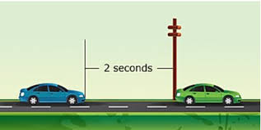
Front proximity monitor
For speeds less than 40 kmph:
Distance range of 0 to 22 meters prompts Warning Level 1.
Distance range of 23 to 45 meters elicits Warning Level 0.
Distance range of 46 to 88 meters corresponds to Warning Level 0.
Distance range of 89 to 120 meters is associated with Warning Level 0.
Distance exceeding 120 meters triggers Warning Level 0.
27

Slide 28
Front proximity monitor contd..
For speeds 40 kmph to 60 kmph:
Distance range of 0 to 22 meters prompts Warning Level 2.
Distance range of 23 to 45 meters elicits Warning Level 1.
Distance range of 46 to 88 meters corresponds to Warning Level 0.
Distance range of 89 to 120 meters is associated with Warning Level 0.
Distance exceeding 120 meters triggers Warning Level 0.
28

Slide 29
Front proximity monitor contd..
For speeds 60 kmph to 90 kmph:
Distance range of 0 to 22 meters prompts Warning Level 3.
Distance range of 23 to 45 meters elicits Warning Level 2.
Distance range of 46 to 88 meters corresponds to Warning Level 1.
Distance range of 89 to 120 meters is associated with Warning Level 0.
Distance exceeding 120 meters triggers Warning Level 0.
29

Slide 30
Front proximity monitor contd..
For speeds above 90 kmph:
Distance range of 0 to 22 meters prompts Warning Level 3.
Distance range of 23 to 45 meters elicits Warning Level 3.
Distance range of 46 to 88 meters corresponds to Warning Level 2.
Distance range of 89 to 120 meters is associated with Warning Level 1.
Distance exceeding 120 meters triggers Warning Level 0.
30

Slide 31
Severities of Front proximity according to speeds
 | <40 kmph | 41 – 60 kmph | 61 – 90 kmph | >90 kmph
0m -22m | 1 | 2 | 3 | 3
23m – 45m | 0 | 1 | 2 | 3
46m – 88m | 0 | 0 | 1 | 2
89m – 120m | 0 | 0 | 0 | 1
>120m | 0 | 0 | 0 | 0
31

Slide 32
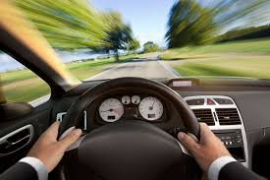
Over Speeding module
The Over speeding Module, designed to monitor vehicle speed, classifies warning levels based on the velocity thresholds as follows:
Speeds ranging from 0 to 80 kilometers per hour (kmph) correspond to Warning Level 0.
Speeds between 81 and 100 kmph elicit Warning Level 1.
Speeds within the range of 101 to 120 kmph are associated with Warning Level 2.
Speeds exceeding 120 kmph prompt Warning Level 3.
32

Slide 33
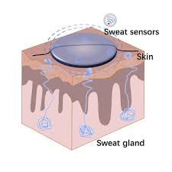
Perspiration Module
The Perspiration Module, designed to measure sweat production, categorizes warning levels based on the volume of perspiration as outlined below:
Perspiration volumes ranging from 0 to 12 milliliters prompt Warning Level 0.
Perspiration volumes between 13 and 23 milliliters elicit Warning Level 1.
Perspiration volumes within the range of 24 to 35 milliliters correspond to Warning Level 2.
Perspiration volumes exceeding 35 milliliters prompt Warning Level 3.
33

Slide 34
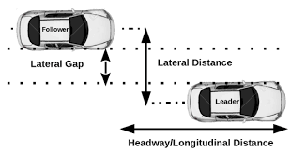
Side Proximity Module
The Side Proximity Sensor Module, designed to detect objects within its vicinity, employs warning levels based on the measured distance, as delineated below:
Distances ranging from 0 to 93 centimeters prompt Warning Level 3.
Distances between 94 and 100 centimeters elicit Warning Level 2.
Distances within the range of 101 to 120 centimeters correspond to Warning Level 1.
Distances exceeding 120 centimeters are associated with Warning Level 0.
34

Slide 35
V. FUTURE SCOPE
Adding More Sensors: Enhanced data collection and broader monitoring capabilities improve system performance and reliability.
Adding Modules of Different Priorities: Modular expansion allows for adaptable and scalable system configurations tailored to specific needs.
Implementing More Accurate Thresholds: Data analysis refines settings, enhancing precision and reducing false alarms or errors.
Versatility Across Industries: Adaptable to diverse safety requirements, making it suitable for a range of industrial applications.
Easily Modifiable Modules: Simplified circuit design enables quick and straightforward modifications for evolving needs.
35

Slide 36
CONCLUSION
The problem statement requires us to implement a digital system for the assessment of the safety of a vehicle. I have decided to use comparators and adders for gaining a sense of severity of the situation and assess them for the collective final output which gives the overall severity level after assessing the high priority and low priority modules
The approach of using a comparator instead a conventional combinational logic circuit has been implemented as it is dynamic and allows the change of threshold values with little to no effort, stage wise evaluation of the system makes it easier to understand and debug and add more enhancements
The device has been tested stage wise and outputs can be demonstrated for the given inputs
The final warning level given by the system can be further used to action as the situation demands
36

Slide 37
VI. References
Y. Choi, S. I. Han, S. -H. Kong and H. Ko, "Driver Status Monitoring Systems for Smart Vehicles Using Physiological Sensors: A safety enhancement system from automobile manufacturers," in IEEE Signal Processing Magazine, vol. 33, no. 6, pp. 22-34, Nov. 2016, doi: 10.1109/MSP.2016.2602095.
Qiong Wang, Huan Wang, Chunxia Zhao and Jingyu Yang, "Driver fatigue detection technology in active safety systems," 2011 International Conference on Remote Sensing, Environment and Transportation Engineering, Nanjing, 2011, pp. 3097-3100, doi: 10.1109/RSETE.2011.5964969.
Fundamental Of Digital Design Logic with Verilog Design by Stephen Brown and Zvonko Vranesic
37

